Slide 1
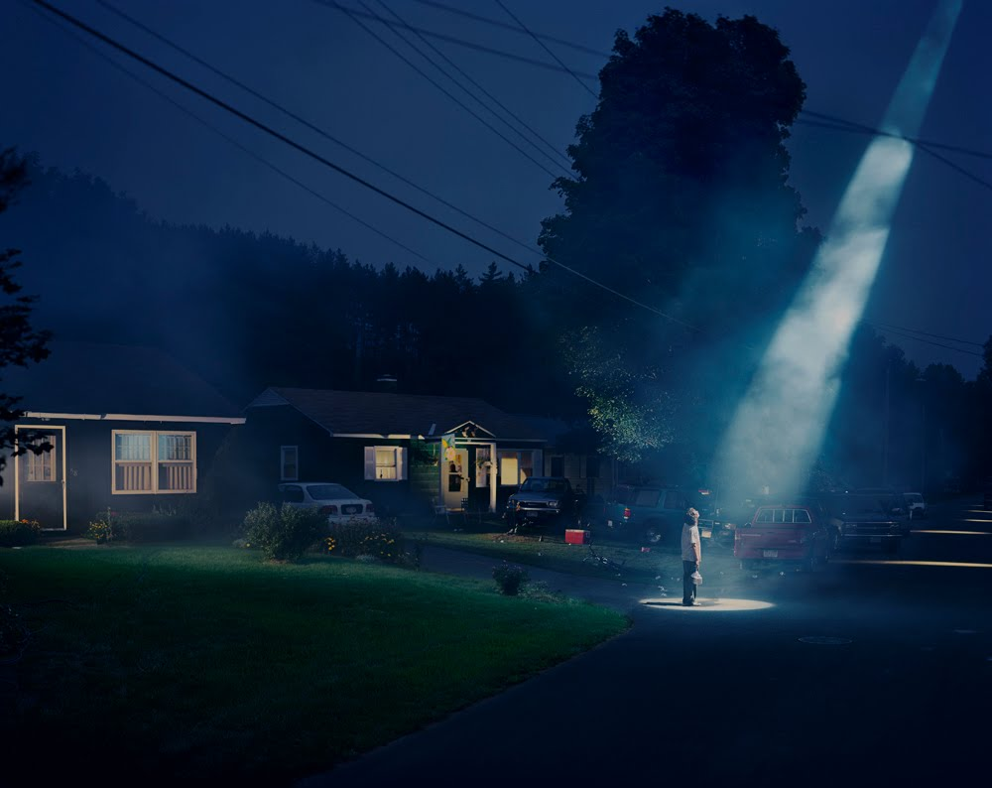
What is the story behind the image?

Slide 2
Narrative Photography

Slide 3
What is Narrative Photography?
Narrative photography is the idea that photographs can be used to tell a story.

Slide 4
Elements of a Narrative
Invisible Photographer
The photographer must be as unobtrusive as possible
A “fly on the wall”

Slide 5
Characters
The event must include the interactions and influences of characters.
Merely photographing objects will not create a narrative.

Slide 6
Narrative Context
Context is created through the inclusion or exclusion of elements in the event being photographed.
Where & When

Slide 7
Starting Questions
What is the story?
Who are the characters?
What is the context (where/when)?

Slide 8
Next Questions…
What is the main subject of this image?
What am I trying to say about my subject?
What is the best angle to showcase my subject?

Slide 9
What should I include in the frame to help tell this story?
What should I exclude from the frame to help tell this story?
When should I click the shutter?

Slide 10
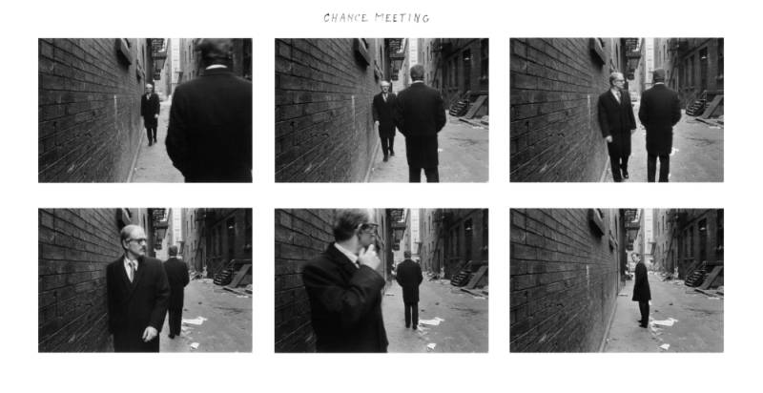
Duane Michals – Chance Meeting

Slide 11
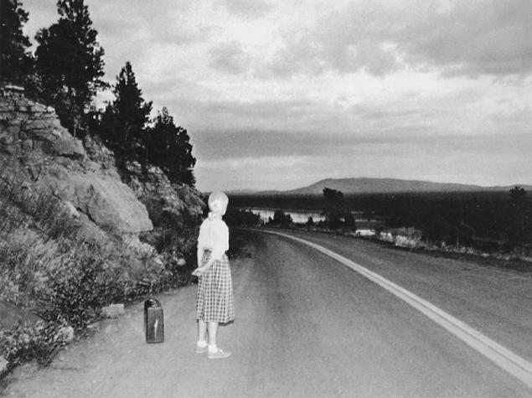
Cindy Sherman – Untitled Film Still

Slide 12
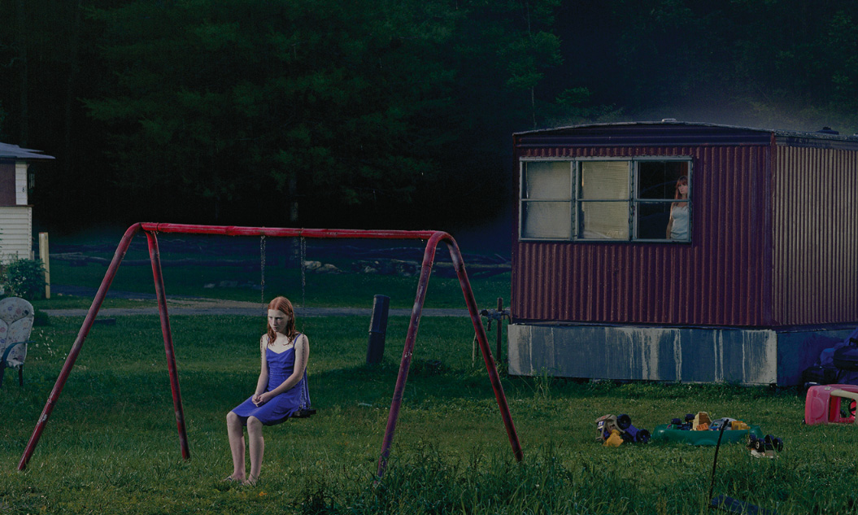
Gregory Crewsdon

Slide 13
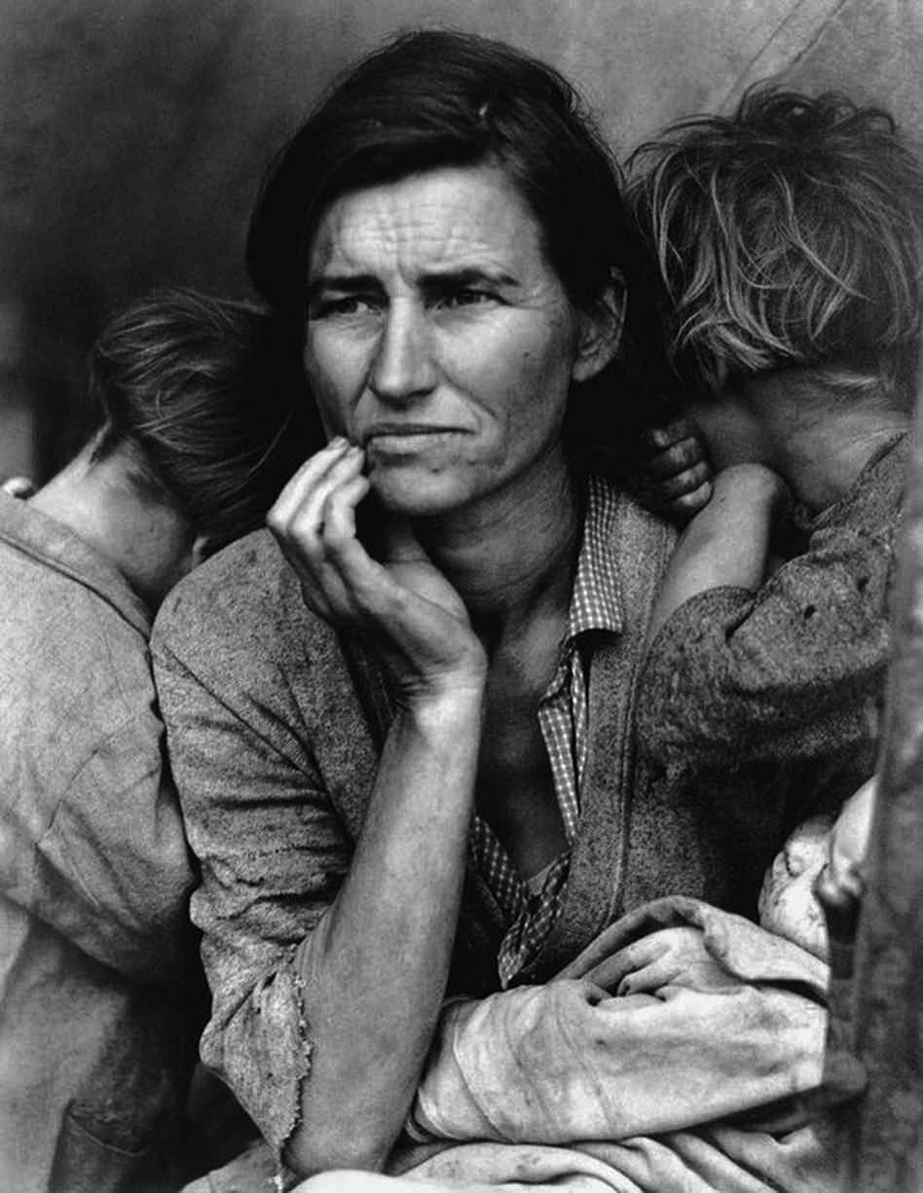
Dorothea Lange –
Migrant Mother

Slide 14
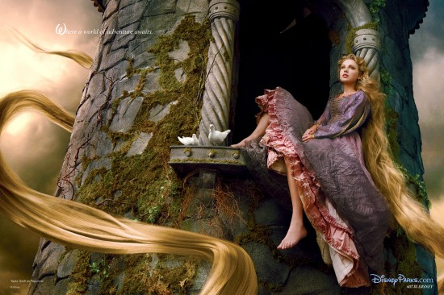
Annie Liebovitz – Disney Series

Slide 15
Head to Your Computer
Let’s learn how to use Padlet!
Add your post-it note comment to our board

Slide 16
Let’s see if you understand…
Open a new Internet Page
Search for a photograph that has narrative qualities
Create a post on our Padlet page and add text – why does this photo fit the definition of a narrative image?

