Slide 1
Spooky

Slide 2
What is Spooky?
Is it a thing we can see?
Is it a thing we can feel?
What does it look like?
What is a concept?
Is the concept of spooky objective or subjective?

Slide 3
What is NOT Spooky?
And just gross and or gory……Let 1st explore what this assignment is NOT about

Slide 4
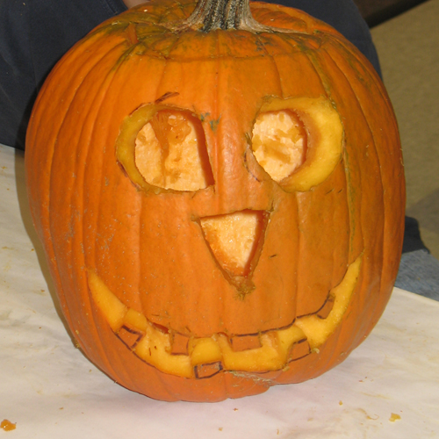

Slide 6
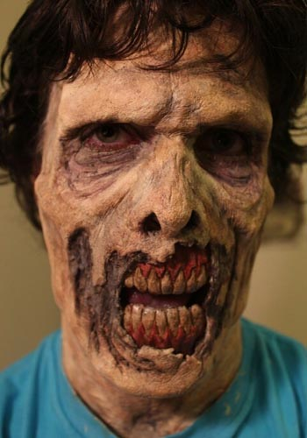

Slide 7
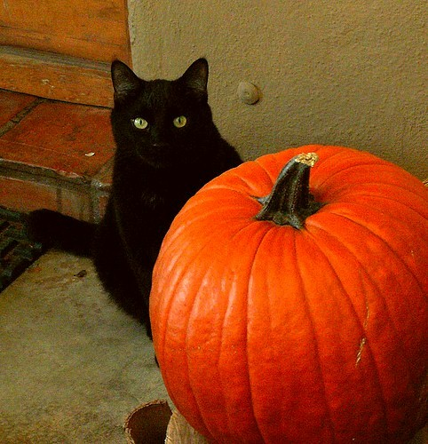

Slide 8
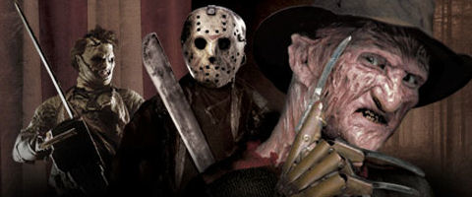

Slide 9
Spooky is not being horrified……it’s when people say
“Feeling uneasy” “Something Not right” “Bad vibes” or energy
“Something’s off about him”
Eerie Feeling Photos!

Slide 10
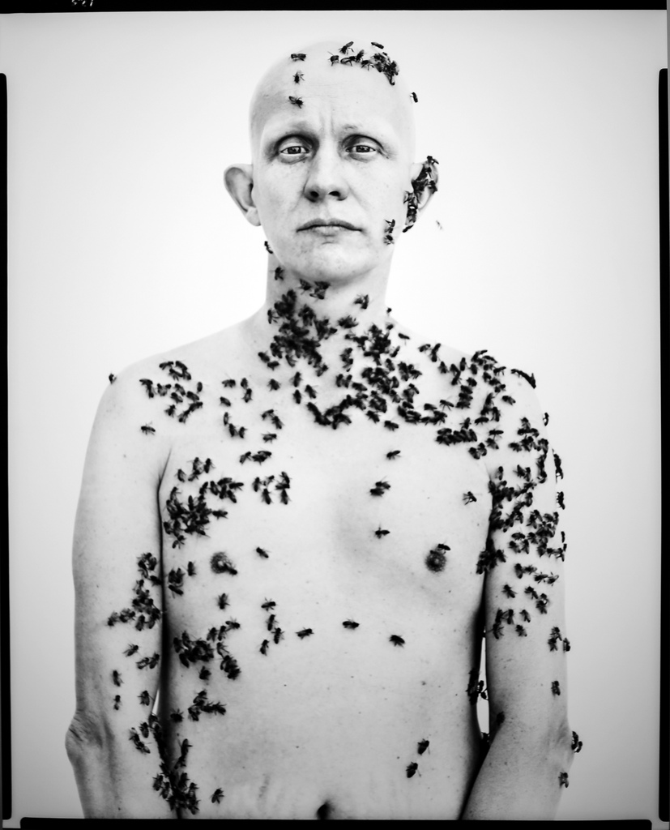
Richard Avedon
“Bee Man”

Slide 11
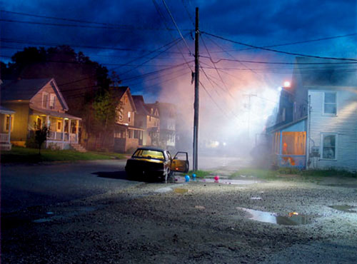
Gregory Crewsdon

Slide 12
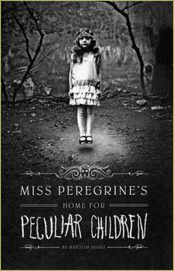
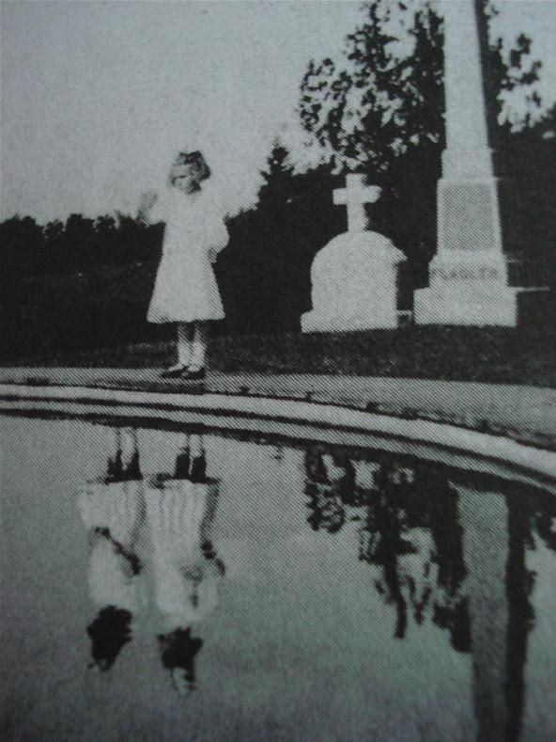

Slide 13
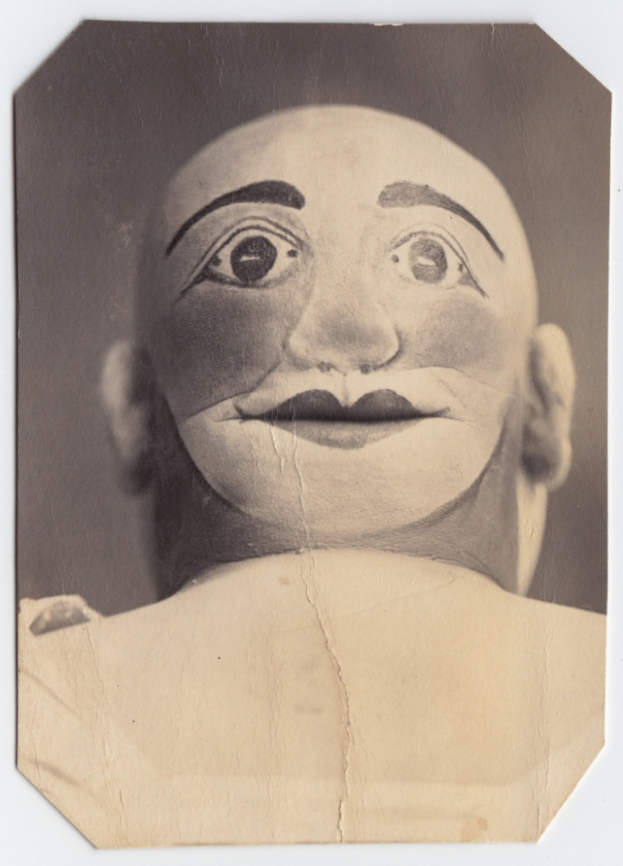

Slide 14
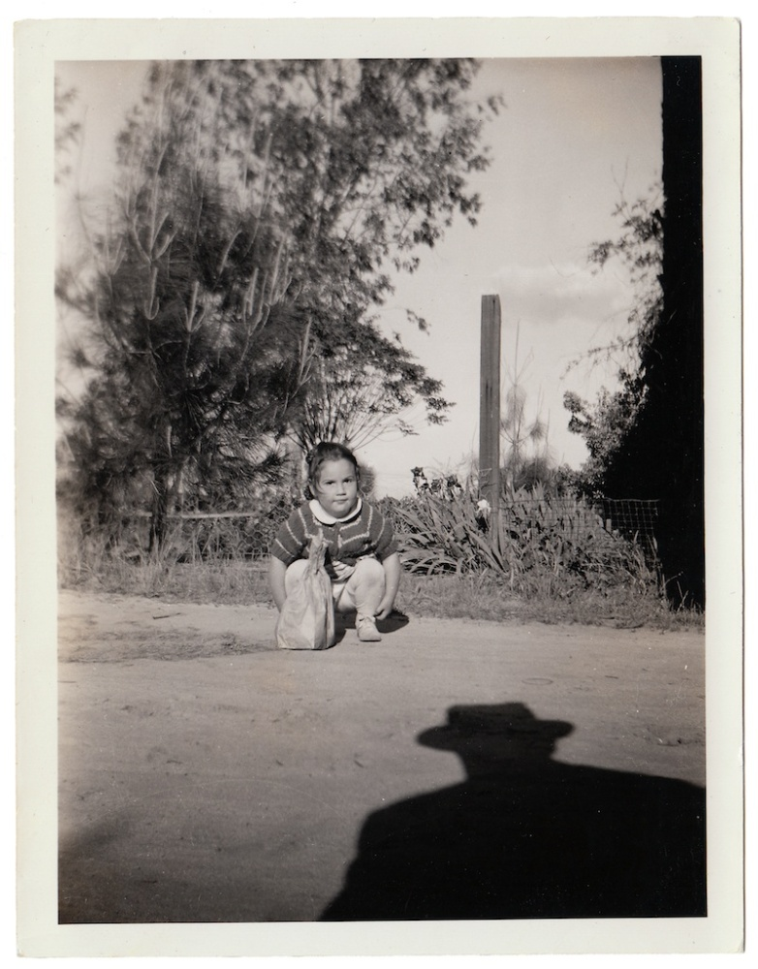

Slide 15
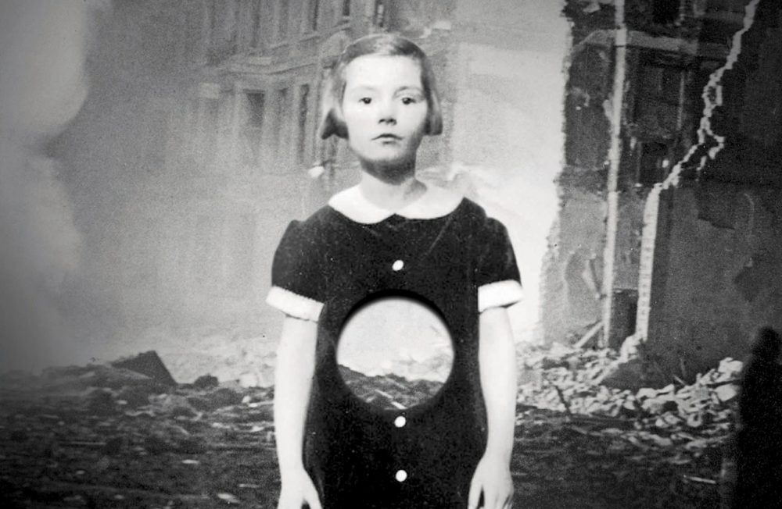

Slide 16
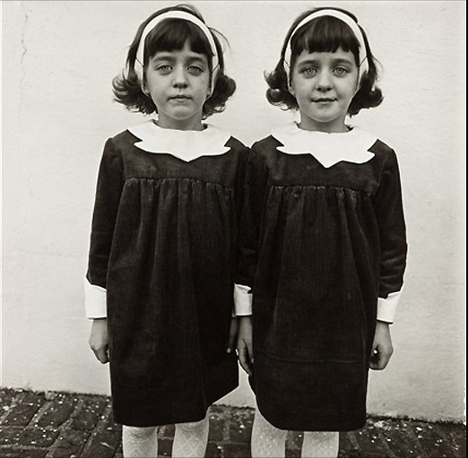
Diane Arbus

Slide 17
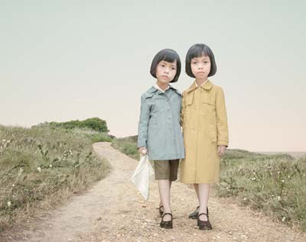
Loretta Lux

Slide 18
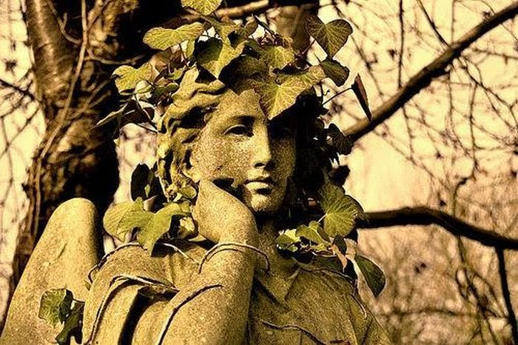

Slide 20
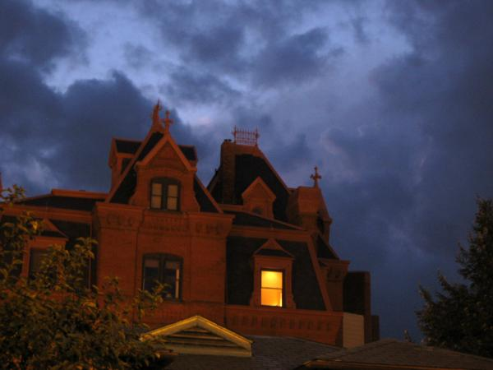

Slide 21
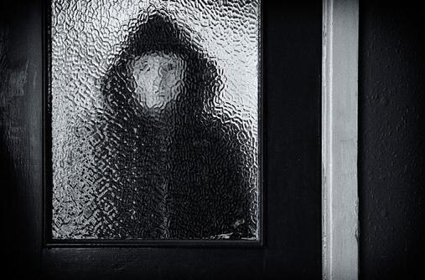

Slide 22
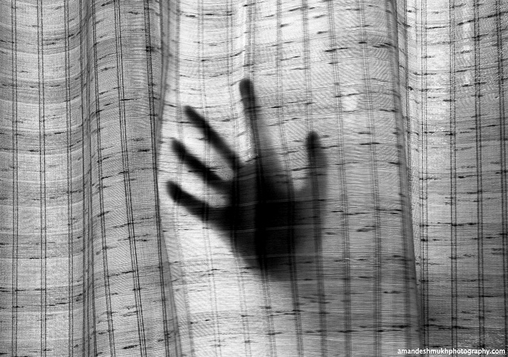

Slide 23
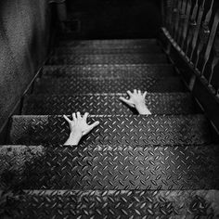
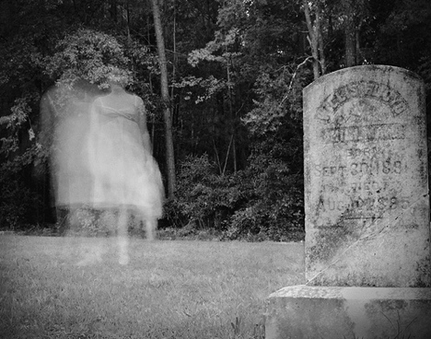

Slide 24
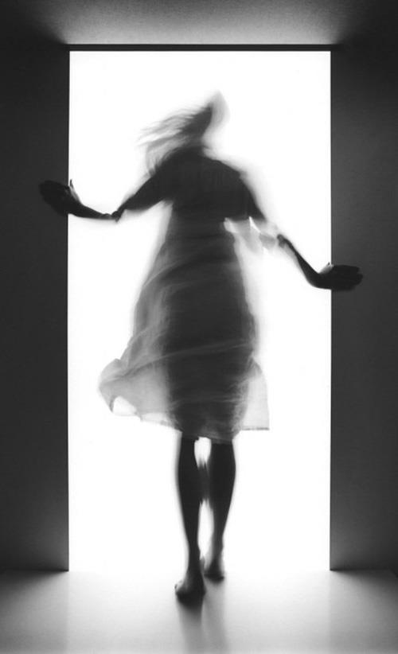
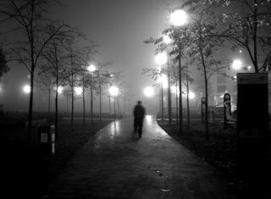

Slide 25
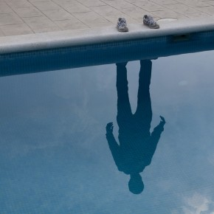

Slide 26
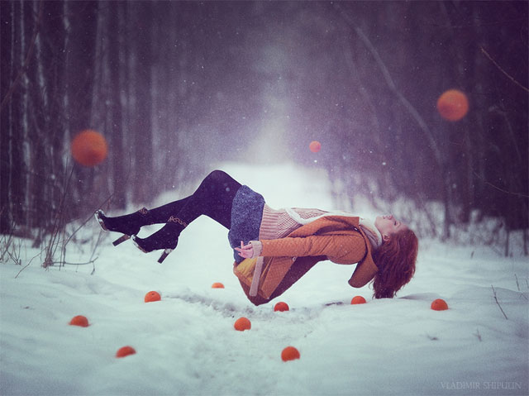

Slide 27
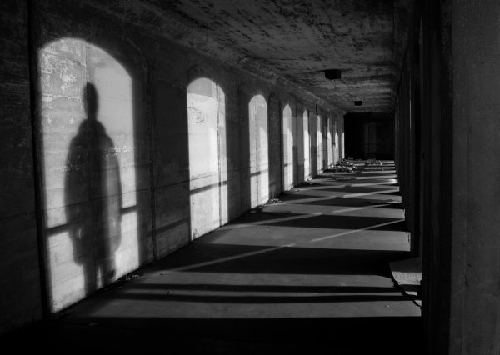

Slide 28
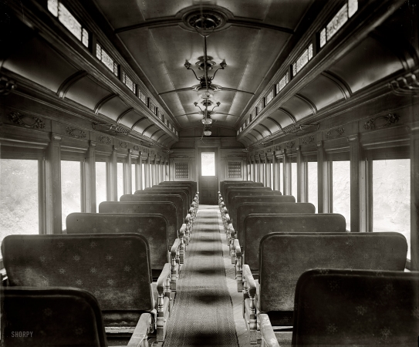

Slide 29
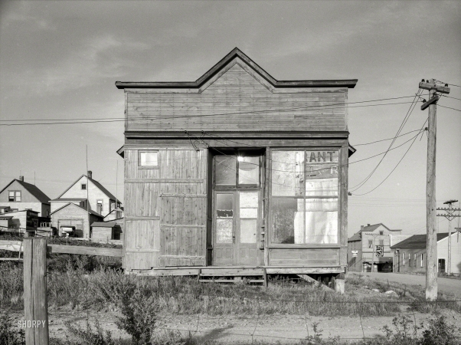

Slide 30
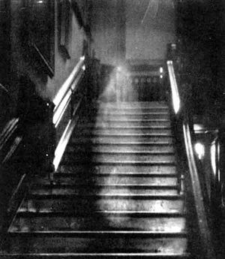

Slide 31
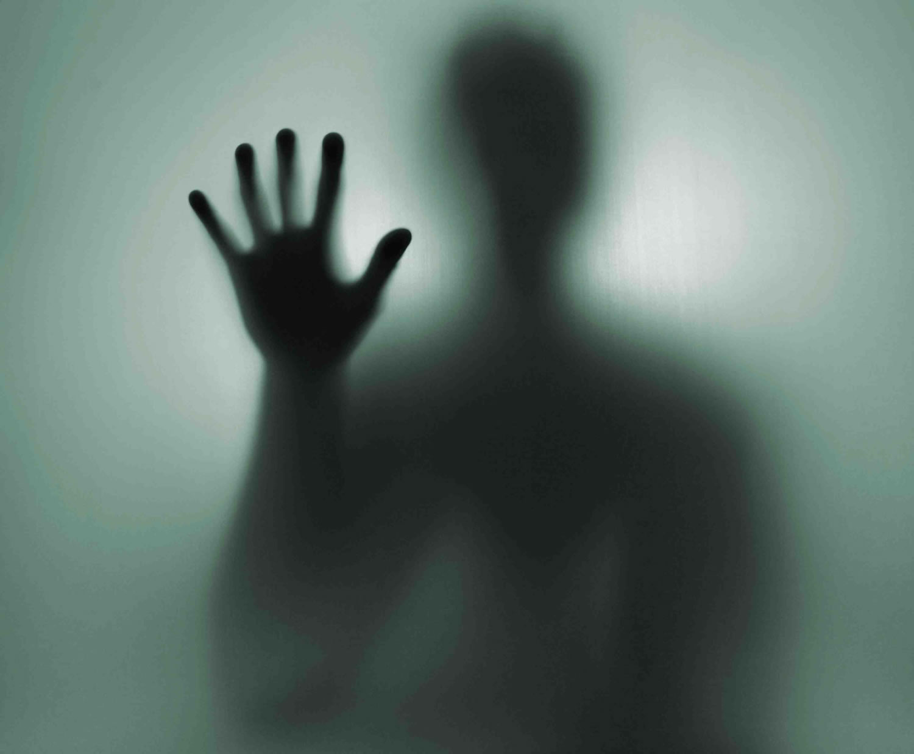

Slide 32
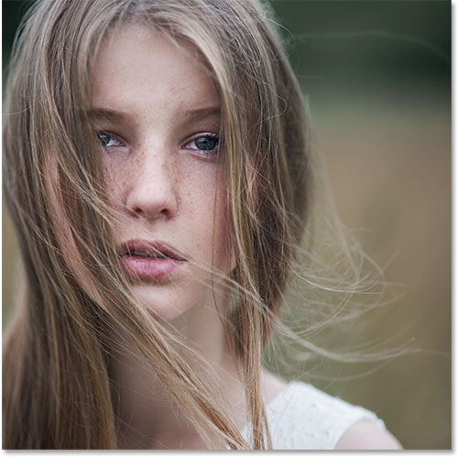
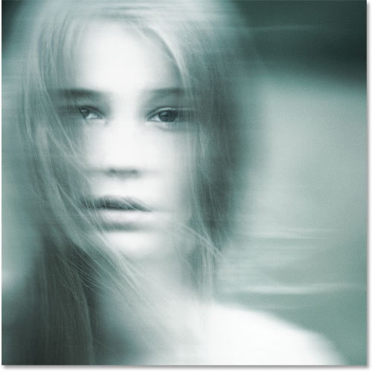
Photoshop Tutorials

Slide 33
Spooky/Perculiar Assignment
Apply at least 3 different tutorials to your spooky photos
DRAW at least 3 sketches of your ideas- have me check them off once finished!
Shoot at least 20 photos that show the feeling or concept of Spooky—not HALLOWEEN.-turn in contact sheet
Turn in 1-3 final photos
Weebly explanations and post of final works!

