Slide 1
Sequential Narration
A SERIES of images that show a beginning, middle, and an end
Four choices:
Grid format (6 panels)
Sequential Motion (6+ images)
Comic Book Page (6+ panel)
Unit Goal: To tell a multiple frame story that includes a beginning, middle, and end.

Slide 2
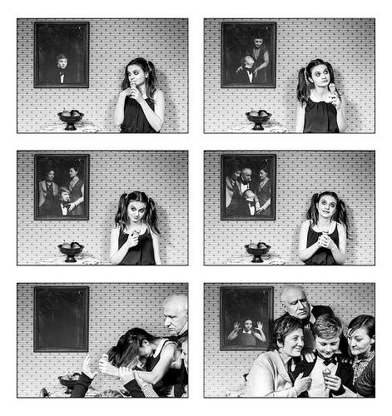
GRID!

Slide 3
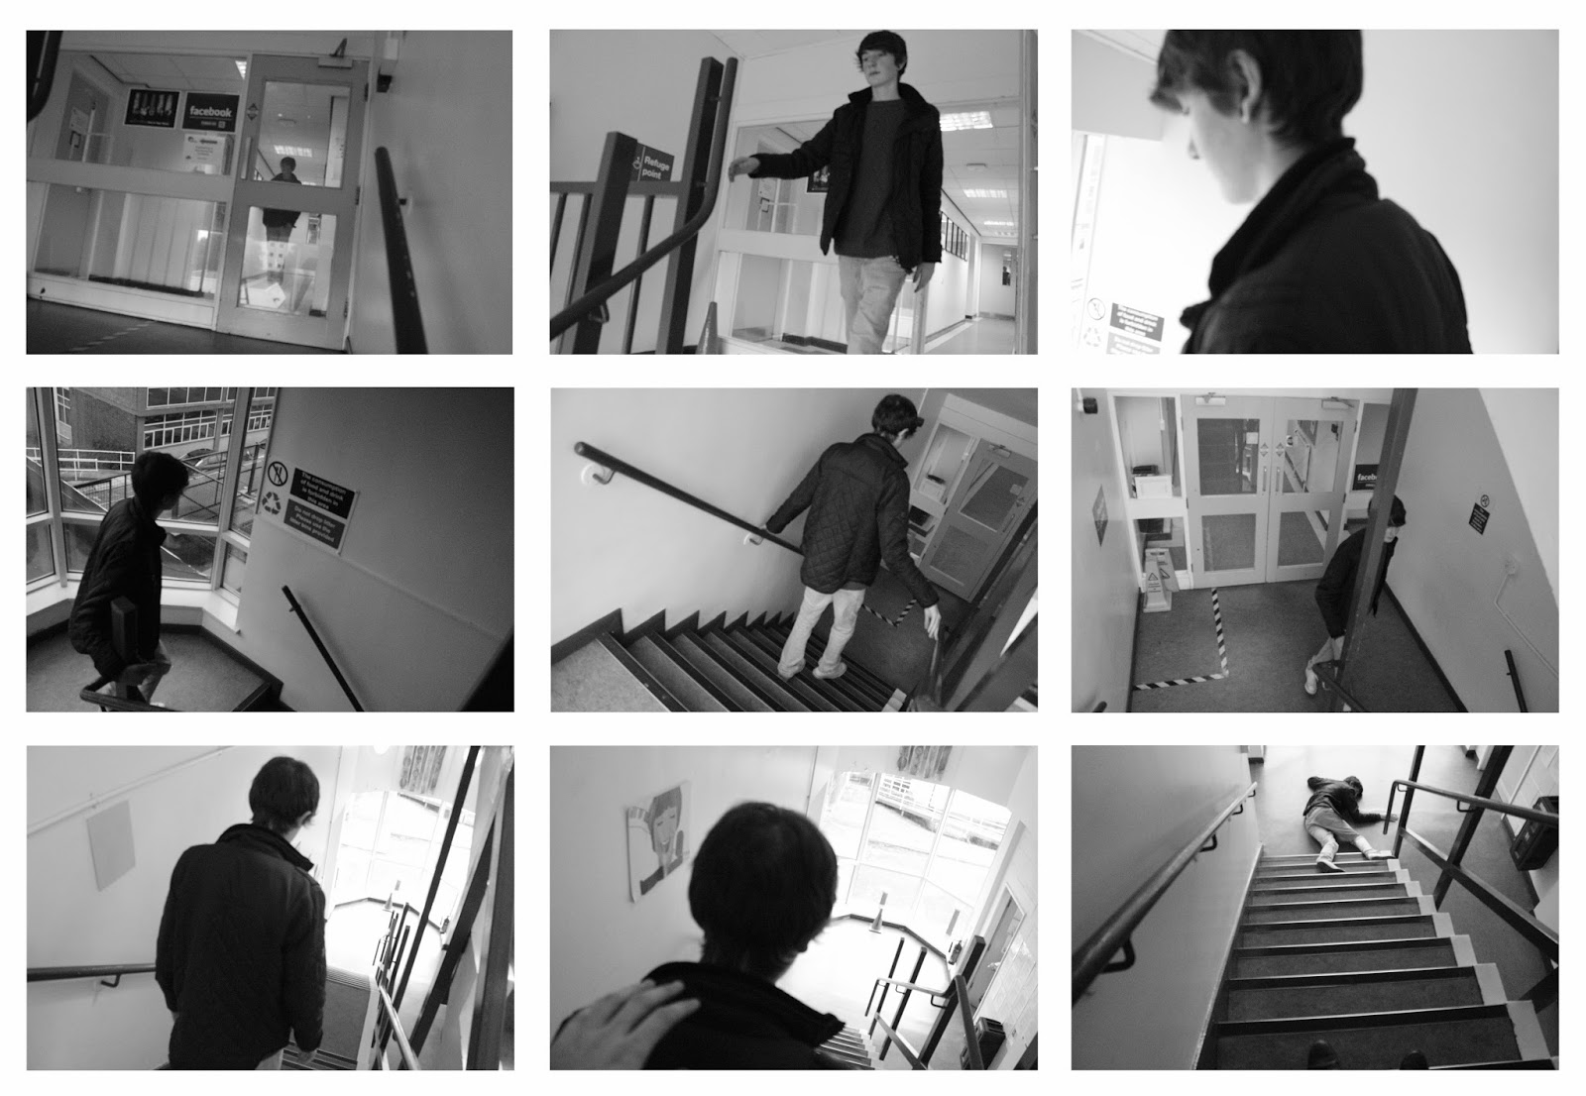

Slide 4
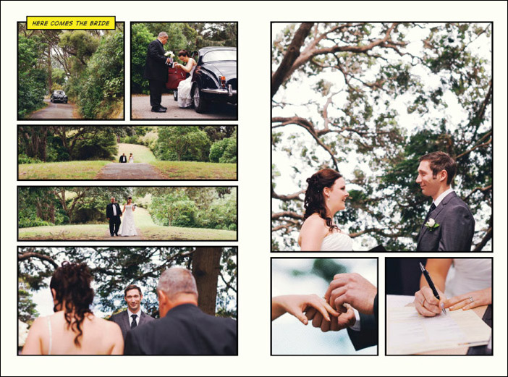

Slide 5
Grid Format
At least 6 images
Place images on a blank canvas/file
Use the View>Show>Grid to line up the images

Slide 6
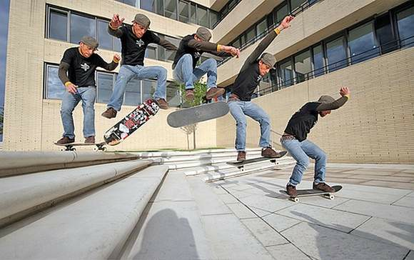
Sequential Motion

Slide 7
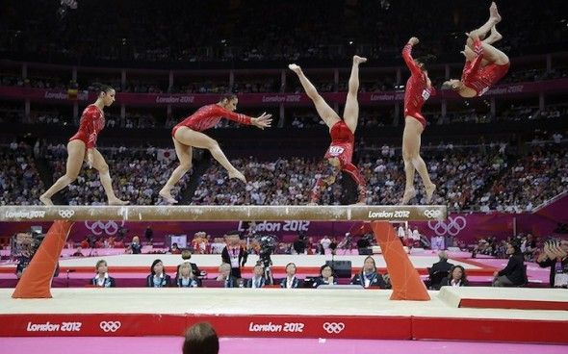

Slide 8
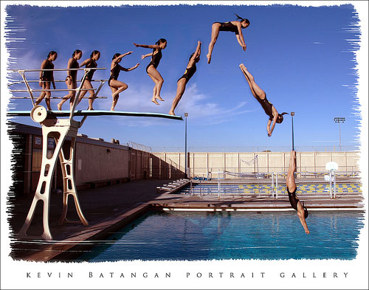

Slide 9
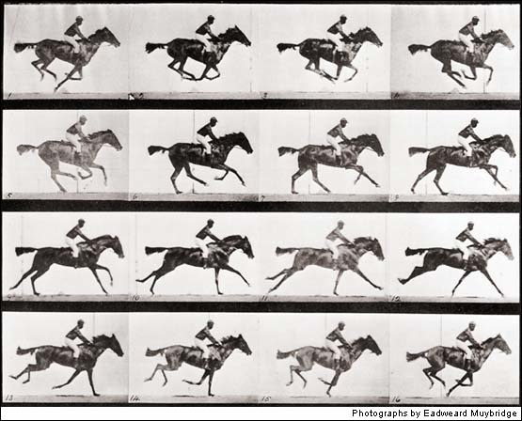

Slide 10
Sequential Motion
A couple ways to do this:
All-in-one
Grid
Video Tutorial for all-in-one
For Grid use a blank canvas to put the image
in and use View>Show>Grid
to help you line them up

Slide 11
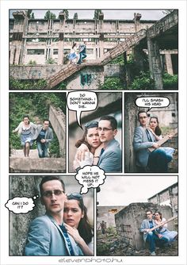
Comic Book Page!

Slide 12
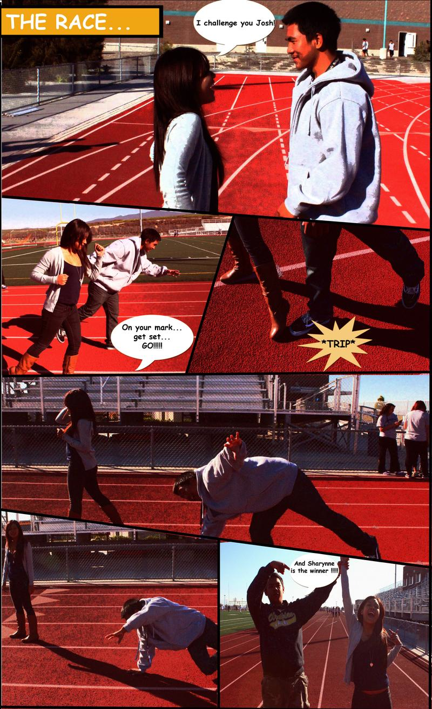

Slide 13
Comic Book Page
At Least 5 panels on the page
Use the tutorial (or find your own) to create the layout and effect

Slide 14
BONUS OPTION: Stop Motion
Takes a LONG time!
Can work with 1-2 other people
Use iPhoto to make a slideshow and then export into iMovie if needed
Sound is a huge component of this!

Slide 15
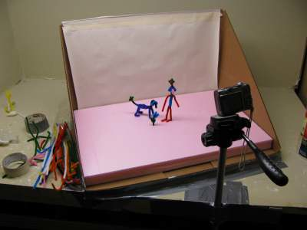

Slide 16
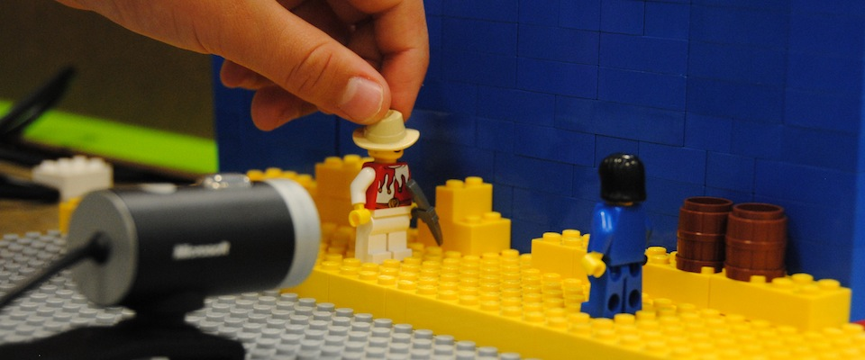

Slide 17
Stop Motion: How to….
50 best stop motion videos
T-shirt Wars Video
OK Go video
Tips to create a stop motion video

Slide 18
Sequential Narration
A SERIES of images that show a beginning, middle, and an end
Four choices:
Grid format (6 panels)
Sequential Motion (6+ images)
Comic Book Page (6+ panels

Slide 19
Unit Goal: To tell a multiple frame story that includes a beginning, middle, and end.
COMPONENTS TO TURN IN:
Planning sketches/sheet
Contact Sheet
Final Edited Project
Reflection
Updated weebly summary and postings

